Slide 1
NOVEL VEHICLE DETECTION AND SEGMENTATION TECHNIQUES FOR AUTONOMOUS VEHICLES
Rajeev Kumar
2100520200054
Institute of Engineering & Technology Lucknow.

Slide 2
PROBLEM STATEMENT
Current vehicle detection methods often fail in complex traffic environments, leading to inaccuracies. This research aims to develop a robust deep-learning model using CNNs and U-Net for precise vehicle detection and segmentation to enhance autonomous driving safety.

Slide 3
METHOD | DESCRIPTION | KEY
Object Detection [1] | Fusion of 3D LIDAR and camera data for object detection in autonomous vehicle applications | Zhao X, Sun P, Xu Z, Min H(2020)
U-Net [4] | Encoder-decoder structure with skip connections for precise segmentation | Ronneberger et al. (2015)
Hybrid Models (CNN + U-Net) [5] | Integrates detection and segmentation frameworks for robust performance | Zhu et al. (2018)
CNNs[6] | Hierarchical feature learning from data for object detection | Krizhevsky et al. (2012)
Mask CNN [3] | Extends Faster R-CNN by adding segmentation mask prediction | Kaiming H , Georgia G, Piotr D, Girshick R (2018)
Object segmentation [2] | Deep dual-modal traffic objects instance segmentation method using camera and LIDAR data for autonomous driving | Geng K, Dong G, Yin G (2020)

Slide 4
1. ENHANCING VEHICLE DETECTION FOR SAFER ROADS DRIVES INNOVATION IN AUTONOMOUS TRANSPORTATION TECHNOLOGIES. 2. COMBINING CNNS AND U-NET MOTIVATES ACCURATE, REAL-TIME SEGMENTATION IN DIVERSE TRAFFIC ENVIRONMENTS. 3. ACHIEVING HIGH ACCURACY IN VEHICLE DETECTION INSPIRES PROGRESS IN INTELLIGENT TRANSPORTATION SYSTEMS. 4. UTILIZING TENSORFLOW MOTIVATES SCALABLE, EFFICIENT SOLUTIONS FOR REAL-WORLD AUTONOMOUS VEHICLE APPLICATIONS. 5. CONTINUOUS MODEL IMPROVEMENT FOSTERS EXCITEMENT FOR BREAKTHROUGHS IN TRAFFIC MANAGEMENT AND ROAD SAFETY.
MOTIVATION

Slide 5
CONTRIBUTION AND NOVELTY
Contribution:
Advanced Feature Extraction and Real-Time Vehicle Detection for Autonomous Transportation Systems. The project uses CNNs for feature extraction, improving real-time vehicle detection and segmentation accuracy.
Novelty:
Combining CNNs and U-Net for Precise Vehicle Segmentation in Complex Traffic Scenarios. The unique integration of CNNs with U-Net ensures high-precision vehicle detection in diverse urban environments.

Slide 6
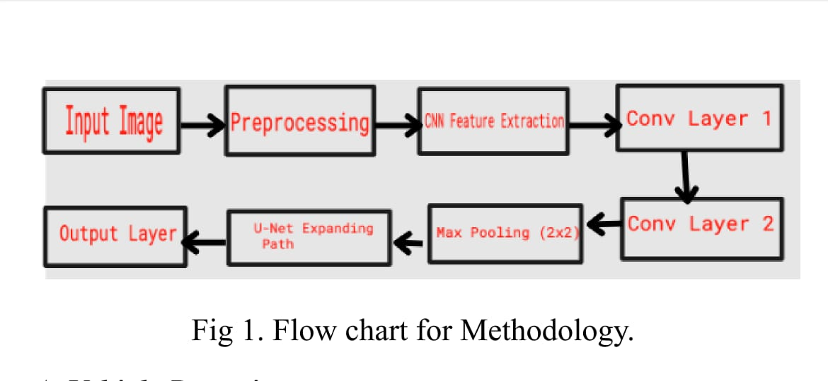
BLOCK DIAGRAM

Slide 7
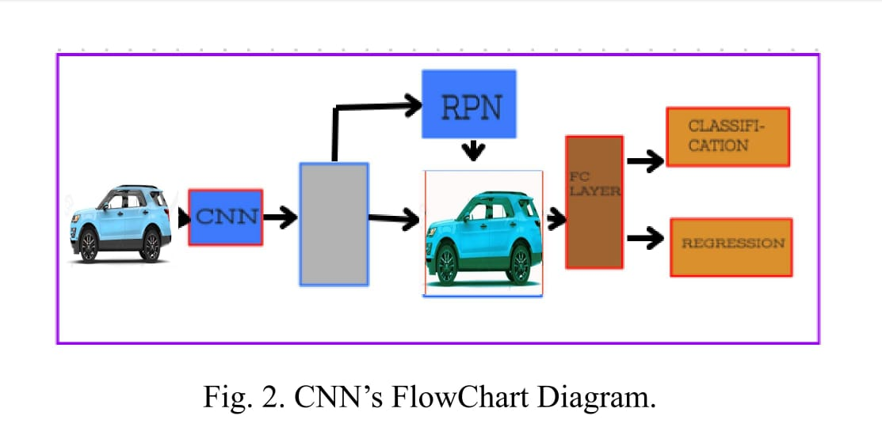
BLOCK DIAGRAM FOR CNN

Slide 8
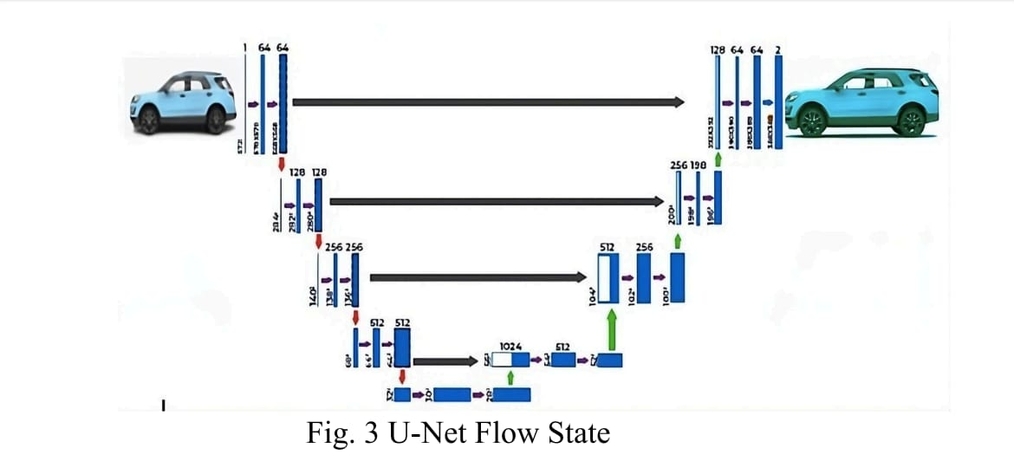
BLOCK DIAGRAM FOR U-NET

Slide 9
DATASET
This dataset is available in Kaggle Datasets [10]and contains 2 Different sections, first is Non-vehicles and another represents vehicles images. along with pixel-level segmentation masks for each image. Both contain 17,762 Images. The dataset was divided into two categories: training and validation sets using a 7033/1759 split. as well as another 7174/1794.

Slide 10
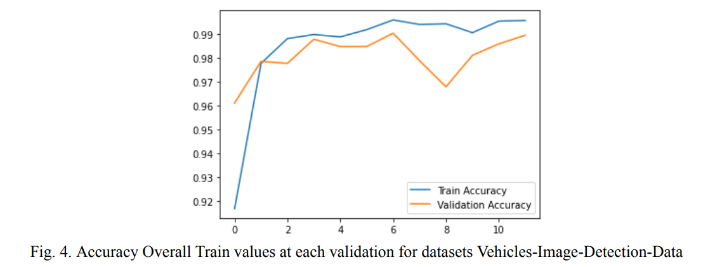
TRAINING AND TESTING
The testing phase extracts the model's performance in their validated set. which is not useful during training of a model. The
Training is a process which is used for splitting to train a validated dataset .This type of set is used to train a model allowing it
to learn from data and also adjust parameters to minimize accepting error. T

Slide 11
CONCLUSION
Implemented in TensorFlow to propose a vehicle identification and segmentation technique. High accuracy, most efficient, and continuous performance of the model in detecting and segmenting vehicles can benefit intelligent transport systems and automated vehicles. The model exhibits strong generalization ability after being trained on a wide range of datasets. Reframing the network design to lower computing expenses will be the focus of future research. Continuous efforts are underway to improve and broaden the uses of this research, which offers a useful tool for enhancing traffic management and road safety.
Future research will focus on enhancing performance and discovering new applications for intelligent transportation systems. This solution combines TensorFlow -based CNNs to improve real-time vehicle detection accuracy and contribute to the evolution of intelligent transportation systems.

Slide 12
RESULTS
Methodology:
In this model create CNN's along with U-Net architecture for obtaining most accurate and efficient vehicles detection and segmentation. The CNN's basically perform to capture and detect the image quality the same as U-Net is combined with CNN performing the feature extraction strengths. after combining both creates a highly efficient vehicle defective tool. Tensor-flow is used for obtaining detective accuracy. The combined model demonstrates high efficiency and accuracy in detecting and segmenting vehicles in diverse conditions as well in heavy-to-light traffic.

Slide 13
RESULT
Result Accuracy:
The Report presents a novel approach to vehicle detection and segmentation using Convolutional Neural Networks (CNNs) and the U-Net architecture. This method is implemented with TensorFlow and designed to accurately identify and segment vehicles in various urban settings. The combined CNN and U-Net architecture extracts detailed features and precisely delineates vehicle boundaries, making it highly effective in different traffic conditions.
Final Report demonstrates that this model, trained on a large dataset, achieves a high accuracy of 99.04%, showcasing its applicability for intelligent transport systems and automated vehicles. Future research aims to improve efficiency and explore broader applications in traffic management.

Slide 14
REFERENCES
[1] Zhao X, Sun P, Xu Z, Min H (2020) “Fusion of 3D LIDAR and camera data for object detection in autonomous vehicle applications”. IEEE Sensors J 20(9):4901–4913.
[2] Geng K, Dong G, Yin G (2020) “Deep dual-modal traffic objects instance segmentation method using camera and LIDAR data for autonomous driving”. Remote Sens 12(20):3274
[3] Kaiming H , Georgia G, Piotr D, Girshick R (2018) “Mask R-CNN. arXiv:1703.06870v3” [cs.CV].
[4] Ronneberger et al. (2015) “Encoder-Decoder Methods for Semantic Segmentation: Efficiency and Robustness Aspects”.IEEE Sensors.
[5] Zhu et al. (2018) “Integrates detection and segmentation frameworks for robust performance Granada,” Spain, pp 126–133

Slide 15
REFERENCES
[6] Krizhevsky et al. (2012) “Hierarchical feature learning from data for object detection”.IEEE Sensors.
[7] Sun J, Wan C, Cheng J, Yu FL, Liu J (2017) Retinal image quality classification using fine-tuned CNN. In: International workshop on fetaland infant image analysis (FIFI) / 4th international workshop on ophthalmic medical image analysis. Granada, Spain, pp 126–133
[8] Rezaei M, Ravanbakhsh E, Namjoo E, Haghighat M (2019) “Assessing the effect of image quality on SSD and faster R-CNN networks for face detection. In: 27th Iranian conference on electrical engineering”.Mashhad, Iran, pp 1589–1594.
[9] Bolya D, Zhou C, Xiao F, Lee YJ (2019) YOLACT: “real-time instance segmentation. In: IEEE/CVF international conference on computervision”. Seoul, South Korea, pp 4493–4497
[10] “Kaggle Vehicles-Image-Detection-Data” (Dataset)

Slide 16
THANK YOU.

